Slide 1


A NOVEL HARMONIC - BASED PHASE SHIFTED CONTROL TO REGULATE TRANSFERRED POWER
Under the esteemed guidance of
Mr. G.KALADHAR , M.Tech,(Ph.D).
PROJECT ASSOCIATES
G.Gopala Rao 11F05A0210
Y.Ravi Teja 10F01A02B7
M.Janardhan Gupta 10F01A0279
SK.Muneer 10F01A02A5

Slide 2
ABSTRACT
The output power is controlled by changing the phase shifted angle of the INVERTER.
To regulate the output power, HPSC method is proposed.
In this method, the switching frequency is much less than the resonant frequency, then the switching losses will be reduced.
By using this method, we can get the good performance at light load conditions also.
Simulated using MATLAB/SIMULINK in power electronics block set.

Slide 3

The main objective of this paper is to improve the
Performance of ICPT (Inductively coupled power transfer) system at wide load range especially at
Light load conditions.
To overcome the drawbacks of FPSC(Fundamental Based Phase-shifted Control) method.
To improve the system efficiency.

Slide 4
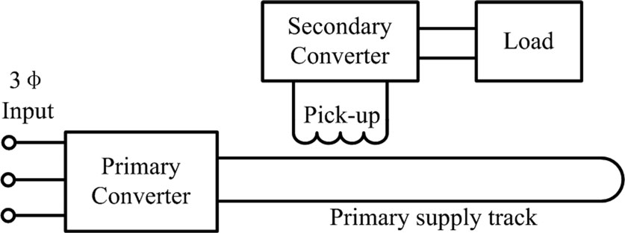
What is ICPT?
ICPT system
utilizes varying magnetic field at a
Certain frequency to couple power across an air gap to one or more secondary load systems without direct physical contact. Which is as shown in figure.

Slide 5
Why ICPT?
It is safe.
It is reliable & flexible.
Environment friendly due to the electrical isolation of the system.
For high power applications it is necessary to regulate the output power , ICPT system is preferred more.
One of the most important application of ICPT is “ RAIL TRANSIT” system.

Slide 6
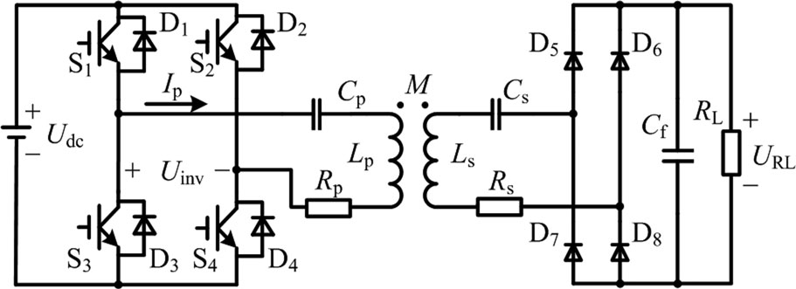
Principle of operation of ICPT system.

Slide 7
FPSC:-
In the cnventional method, the power is transferred by fundamental component, and the harmonic components are neglected.
So, the conventional phase shifted control is called fundamental based phase shifted control (FPSC)
In conventional FPSC, the efficiency is poor at light load condition when “α” approaches to 0◦ to 180◦.

Slide 8
HPSC:-
To transfer the power in FPSC, the harmonic component of inverter output voltage is used by changing the switching frequency.
Whereas in HPSC , to regulate the output power accurately phase shifted control is used.
The switching frequency could be decreased to 1/k times of the resonant frequency. Therefore the output power can be regulated by changing the phase shifted angel .

Slide 9
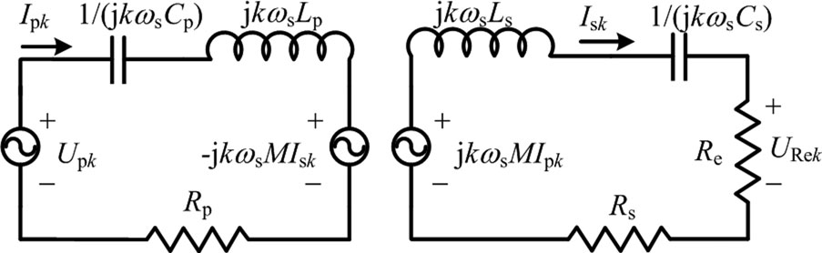
Harmonic model equivalent circuit of ICPT with series compensation.

Slide 10
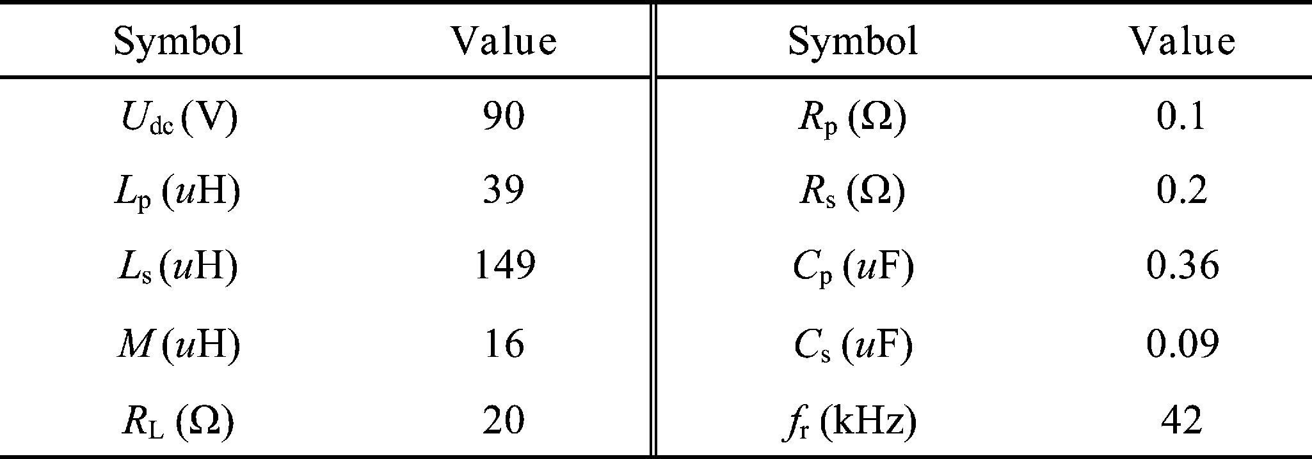
SIMULATION AND EXPERIMENTAL PARAMETERS
Upk =2√2/kπ Udc cos kα/2 (k = 1, 3, 5, 7 . . .).

Slide 11
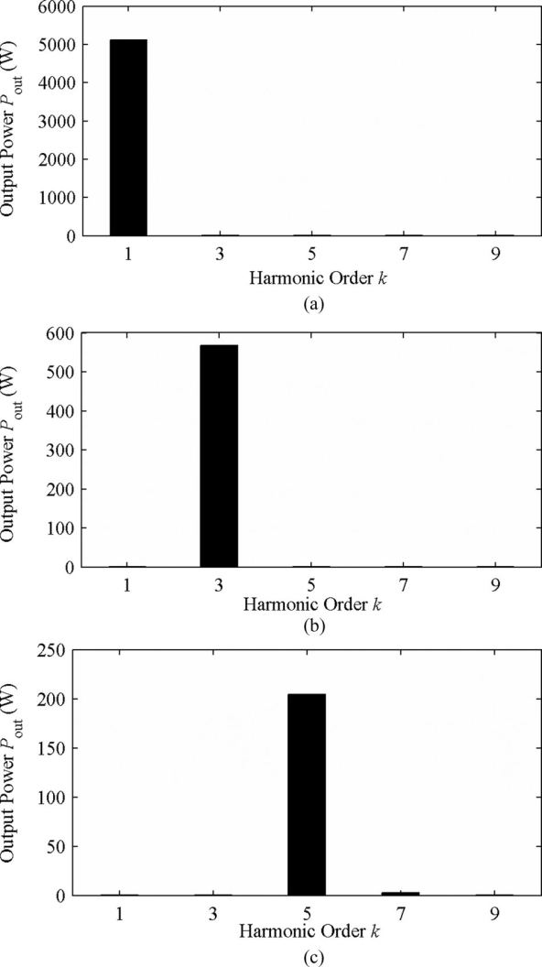

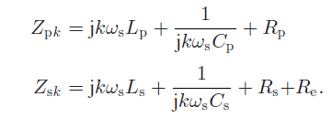
Fig. (c). Output power with different harmonic components under f = 42 kHz:
(a) fs = 42 kHz, (b) fs = 14 kHz, and (c) fs = 8.4 kHz

Slide 12
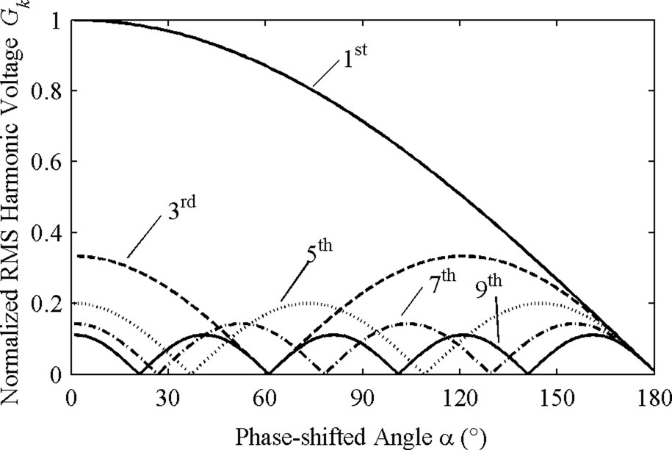
Normalized value of fundamental and harmonic components at different phase-shifted angle.
phase-shifted angle α is expressed as
Gk = Upk/Up1 =
1/k cos kα/2 where (k = 1, 3, 5, 7 . . .).

Slide 13
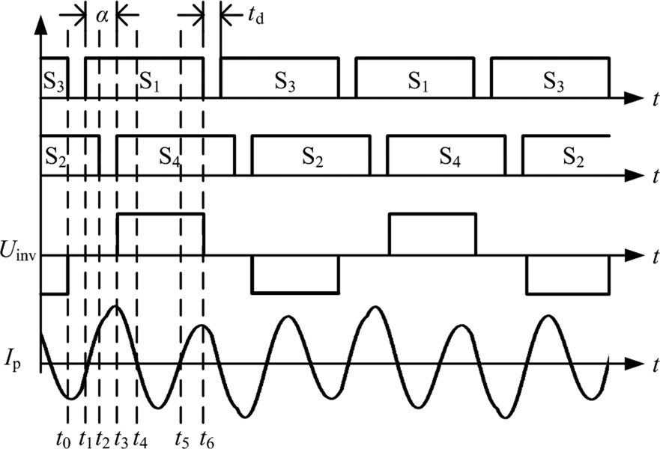
Key waveforms of HPSC with third-order harmonic

Slide 14
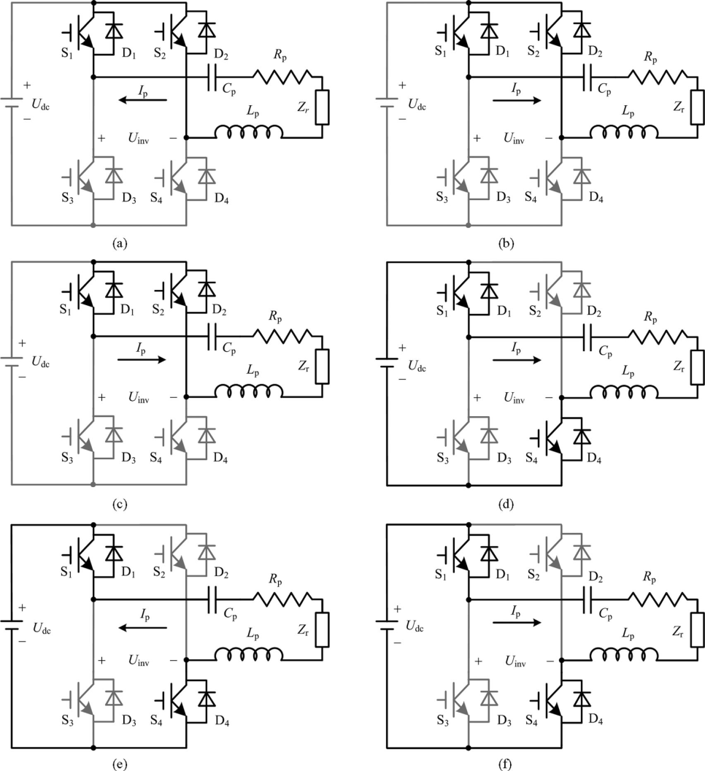
Simplified paths of HPSC with third-order harmonic in half switching period.

Slide 15
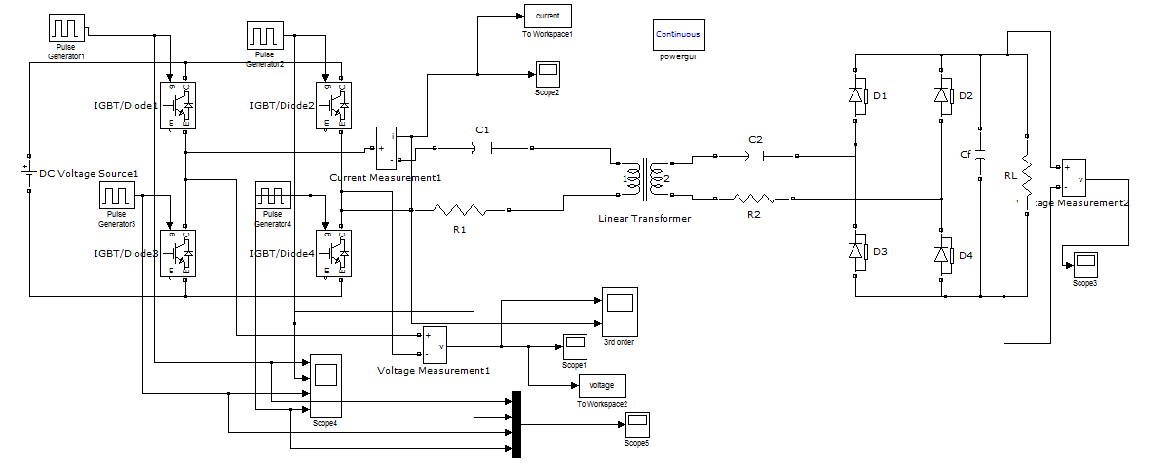
Simulink Program for FPSC,HPSC.

Slide 16
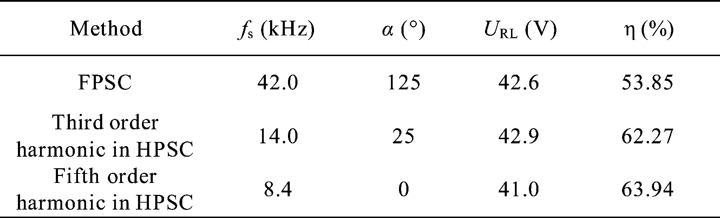
EXPERIMENTAL DATA WITH DIFFERENT CONTROL METHODS

Slide 17
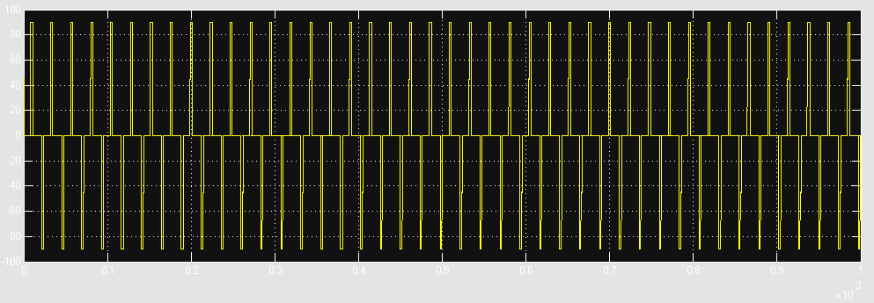
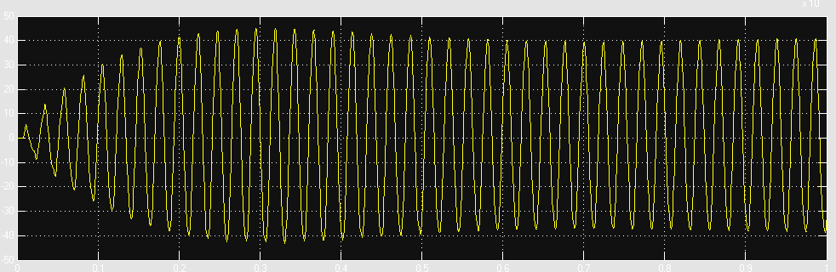
Waveforms of the inverter output voltage and current using different control methods. (a) FPSC. (b) Third-order harmonic in HPSC. (c) Fifth order harmonic in HPSC

Slide 18
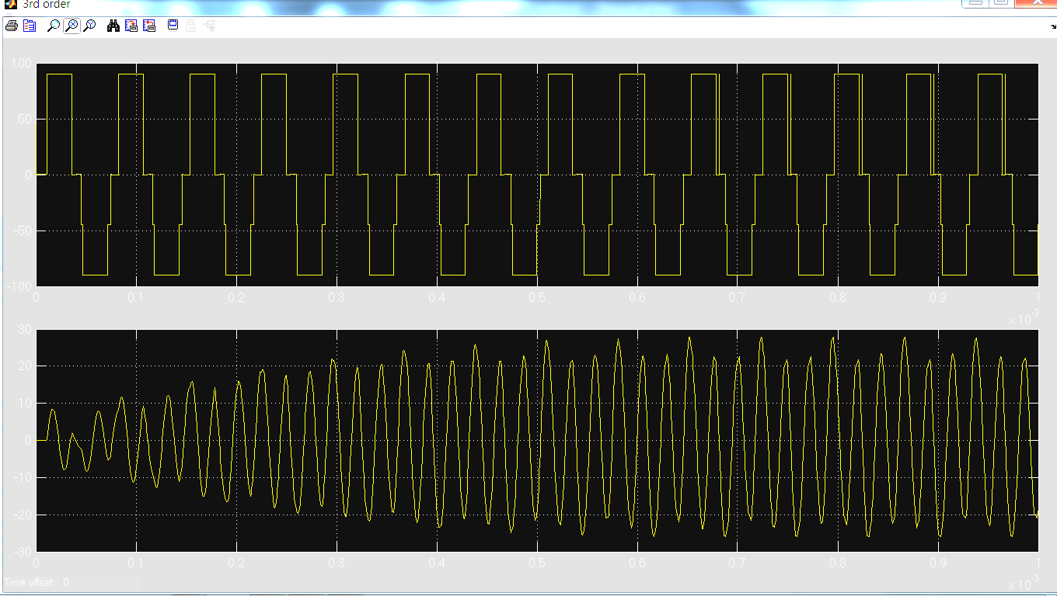
Output waveforms of the inverter at third-order harmonic in HPSC.

Slide 19
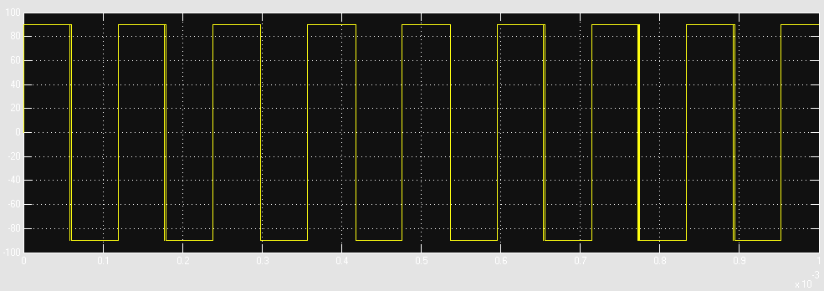
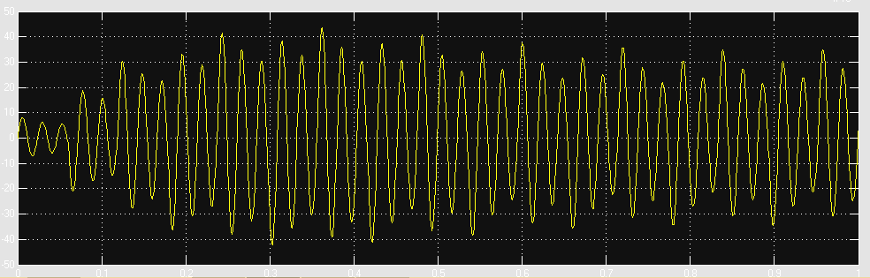
output waveforms of the inverter at fifth-order harmonic in HPSC.

Slide 20
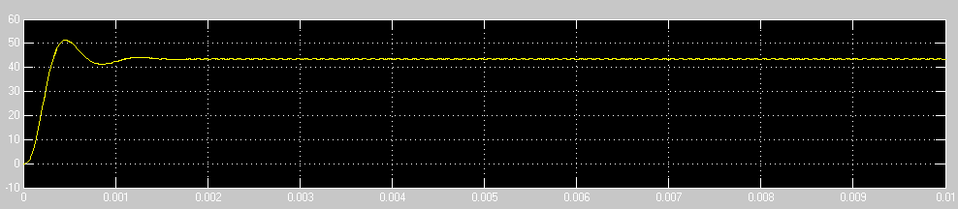
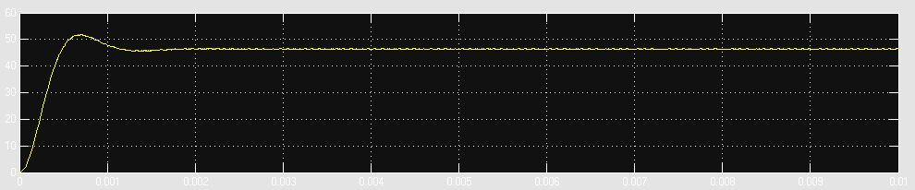
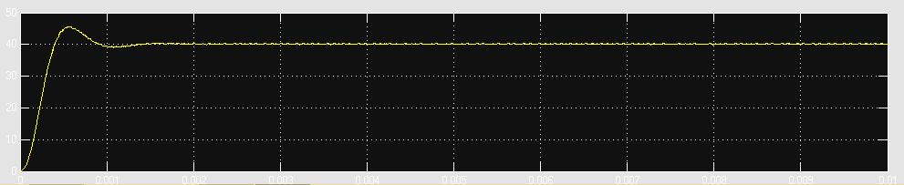
OUTPUT VOLTAGE AT DIFFERENT CONTROL METHODS:

Slide 21
CONCLUSION
Analyses and experimental results shows that the proposed method can improve system efficiency remarkably compared with the traditional fundamental- based phase shift control. Furthermore, improved power regulation precision and reduced switching frequency have been achieved simultaneously.

Slide 22


Slide 23


Slide 24
REFERENCES.
1] A. K. Swain, M. J. Neath, U. K. Madawala, and D. J. Thrimawithana,
“A dynamic multivariable state-space model for bidirectional inductive
power transfer systems,” IEEE Trans. Power Electron., vol. 27, no. 11,
pp. 4772–4780, Nov. 2012.
[2] H.Matsumoto, Y. Neba, K. Ishizaka, and R. Itoh, “Model for a three-phase
contactless power transfer system,” IEEE Trans. Power Electron., vol. 26,
no. 9, pp. 2676–2687, Sep. 2011.
[3] Y. Ota, T. Takura, F. Sato, H.Matsuki, T. Sato, and T. Nonaka, “Impedance
matching method about multiple contactless power feeding system for
portable electronic devices,” IEEE Trans.Magn., vol. 47, no. 10, p. 4235—
4237, Oct. 2011.
[4] S. Hasanzadeh, S. Vaez-Zadeh, and A.H. Isfahani, “Optimization of a
contactless power transfer system for electric vehicles,” IEEE Trans. Veh.
Technol., vol. 61, no. 8, pp. 3566–3573, Oct. 2012.

